Slide 1
Chapter 4
Lexical and Syntax Analysis

Slide 2
Chapter 4 Topics
Introduction
Lexical Analysis
The Parsing Problem
Recursive-Descent Parsing
Bottom-Up Parsing
Copyright © 2015 Pearson. All rights reserved.
1-<number>

Slide 3
Introduction
Book explains compiler design would take at least one semester of intensive study.
So why look at it here in Programming languages –
1. They use the information from Chap. 3,
BNF and Grammars.
2. Lexical and Syntax analyzers are used
outside Compiler design.
This is an overview of Lexical and Syntax analyzers.
Copyright © 2015 Pearson. All rights reserved.
1-<number>

Slide 4
Introduction
Review Chapeter One:
Three different approaches to implementing programming languages are introduced in Chapter 1:
Compilation
Pure interpretation
Hybrid implementation
Copyright © 2015 Pearson. All rights reserved.
1-<number>

Slide 5
Introduction
Review Chapeter One:
Compilation -
uses a program called a compiler, which translates programs written in a high-level programming language into machine code. Compilation is typically used to implement programming languages that are used for large applications, often written in languages such as C++ and COBOL.
Copyright © 2015 Pearson. All rights reserved.
1-<number>

Slide 6
Introduction
Review Chapeter One:
Pure interpretation -
perform no translation; rather, programs are interpreted in their original form by a software interpreter. Pure interpretation is usually used for smaller systems in which execution efficiency is not critical, such as scripts embedded in HTML documents, written in languages such as JavaScript.
Copyright © 2015 Pearson. All rights reserved.
1-<number>

Slide 7
Introduction
Review Chapeter One:
Hybrid implementation -
Hybrid implementation systems translate programs written in high-level languages into intermediate forms, which are interpreted. Written in languages such as Java.
Copyright © 2015 Pearson. All rights reserved.
1-<number>

Slide 8
Introduction
Language implementation systems must analyze source code, regardless of the specific implementation approach,
So all three of the previous implementations use both lexical and syntax analyzers.
Nearly all syntax analysis is based on a formal description of the syntax of the source language (BNF) and have Attribute Grammars.
Copyright © 2015 Pearson. All rights reserved.
1-<number>

Slide 9
Syntax Analysis
The syntax analysis portion of a language processor nearly always consists of two parts:
  A low-level part called a lexical analyzer (mathematically, a finite automaton based on a regular grammar)
  A high-level part called a syntax analyzer, or parser (mathematically, a push-down automaton based on a context-free grammar, or BNF)
Copyright © 2015 Pearson. All rights reserved.
1-<number>

Slide 10
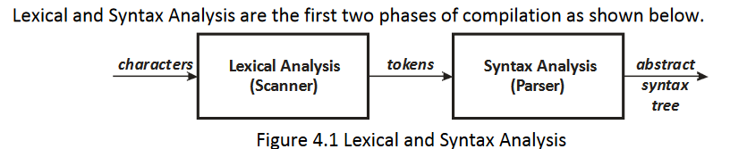
Overview -
Copyright © 2015 Pearson. All rights reserved.
1-<number>

Slide 11
Advantages of Using BNF to Describe Syntax
Provides a clear and concise syntax description
The parser can be based directly on the BNF
Parsers based on BNF are easy to maintain
Copyright © 2015 Pearson. All rights reserved.
1-<number>

Slide 12
Reasons to Separate Lexical and Syntax Analysis
Simplicity - less complex approaches can be used for lexical analysis; separating them simplifies the parser
Efficiency - separation allows optimization of the lexical analyzer
Portability - parts of the lexical analyzer may not be portable, but the parser always is portable
Copyright © 2015 Pearson. All rights reserved.
1-<number>

Slide 13
Lexical Analysis
A lexical analyzer is a pattern matcher for character strings
A lexical analyzer is a “front-end” for the parser
Identifies substrings of the source program that belong together - lexemes
  Lexemes match a character pattern, which is associated with a lexical category called a token
  oldsum is a lexeme; its token may be IDENT
  result = oldsum - value / 100;
  - Matched Lexemes are replaced with the token during the parsing
Copyright © 2015 Pearson. All rights reserved.
1-<number>

Slide 14
Lexical Analysis (continued)
The lexical analyzer is usually a function that is called by the parser when it needs the next token
The lexical analyzer process includes skipping comments and white spaces
Three approaches to building a lexical analyzer:
  Write a formal description of the tokens and use a software tool that constructs a table-driven lexical analyzer from such a description
  Design a state diagram that describes the tokens and write a program that implements the state diagram
  Design a state diagram that describes the tokens and hand-construct a table-driven implementation of the state diagram
Copyright © 2015 Pearson. All rights reserved.
1-<number>

Slide 15
State Diagram Design
  A native state diagram would have a transition from every state on every character in the source language - such a diagram would be very large!
  There are ways to make SD smaller and finite
Copyright © 2015 Pearson. All rights reserved.
1-<number>

Slide 16
Lexical Analysis (make SD smaller)
In many cases, transitions can be combined to simplify the state diagram
  When recognizing an identifier, all uppercase and lowercase letters are equivalent
    Use a character class that includes all letters
  When recognizing an integer literal, all digits are equivalent - use a digit class
Copyright © 2015 Pearson. All rights reserved.
1-<number>

Slide 17
Lexical Analysis (make SD smaller)
Reserved words and identifiers can be recognized together (rather than having a part of the diagram for each reserved word)
  Use a table lookup to determine whether a possible identifier is in fact a reserved word
Copyright © 2015 Pearson. All rights reserved.
1-<number>

Slide 18
Lexical Analysis (make SD smaller)
Convenient utility subprograms for common tasks:
  getChar - gets the next character of input, puts it in nextChar, determines its class and puts the class in charClass
  addChar - puts the character from nextChar into the place the lexeme is being accumulated, lexeme
  lookup - determines whether the string in lexeme is a reserved word (returns a code)
Copyright © 2015 Pearson. All rights reserved.
1-<number>

Slide 19
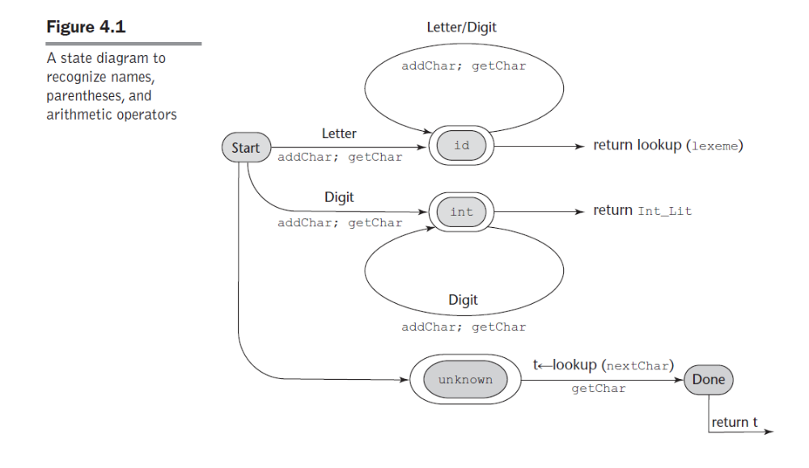
State Diagram
Copyright © 2015 Pearson. All rights reserved.
1-<number>

Slide 20
Lexical Analyzer
Implementation: code example in text book
→ SHOW front.c (pp. 172-177)
- Following is the output of the lexical analyzer of
front.c when used on (sum + 47) / total
Next token is: 25 Next lexeme is (
Next token is: 11 Next lexeme is sum
Next token is: 21 Next lexeme is +
Next token is: 10 Next lexeme is 47
Next token is: 26 Next lexeme is )
Next token is: 24 Next lexeme is /
Next token is: 11 Next lexeme is total
Next token is: -1 Next lexeme is EOF
Copyright © 2015 Pearson. All rights reserved.
1-<number>

Slide 21
The Parsing Problem
Goals of the parser, given an input program:
  Find all syntax errors; for each, produce an appropriate diagnostic message and recover quickly
  Produce the parse tree, or at least a trace of the parse tree, for the program
Copyright © 2015 Pearson. All rights reserved.
1-<number>

Slide 22
The Parsing Problem (continued)
Two categories of parsers
  Top down - produce the parse tree, beginning at the root
    Order is that of a leftmost derivation
    Traces or builds the parse tree in preorder
  Bottom up - produce the parse tree, beginning at the leaves
    Order is that of the reverse of a rightmost derivation
Useful parsers look only one token ahead in the input
Either way, output is a parse tree (abstract syntax tree)
Both parse trees and derivations include all of the syntactic information needed by a language processor.
Copyright © 2015 Pearson. All rights reserved.
1-<number>

Slide 23
The Parsing Problem (continued)
Top-down Parsers
  Given a sentential form, xAα , the parser must choose the correct A-rule to get the next sentential form in the leftmost derivation, using only the first token produced by A
  Note: x is string of terminal symbols, A is a nonterminal, and α is a mixture.
The most common top-down parsing algorithms:
  Recursive descent - a coded implementation
  LL parsers - table driven implementation
  Note: first L means Left-to-Right, second L means Left Most
Copyright © 2015 Pearson. All rights reserved.
1-<number>

Slide 24
The Parsing Problem (continued)
Bottom-up parsers
  Given a right sentential form, α, determine what substring of α is the right-hand side of the rule in the grammar that must be reduced to produce the previous sentential form in the right derivation
  The most common bottom-up parsing algorithms are in the LR family
  What does the LR stand for?
Copyright © 2015 Pearson. All rights reserved.
1-<number>

Slide 25
Extra :
http://cs2.uco.edu/~trt/cs4023/ch04.pdf
Introduction to Parsing
Parsers for programming languages construct parse trees for given programs.
There are two distinct goals of syntax analysis:
The parser determines if the input program is syntactically
correct.
1.1. If an error is found, the parser generates a diagnostic
message indicating the location of the error and a
message that indicates why the program is not correct.
2. The parser produces a parse tree of a syntactically correct program.
Copyright © 2015 Pearson. All rights reserved.
1-<number>

Slide 26
Extra :
There are two broad classes of parsers.
1. top-down: A top-down parser attempts to construct the parse tree from the root down to its leaves.
2. bottom-up: A bottom-up parser attempts to construct the parse tree from its leaves upward to the root.
Copyright © 2015 Pearson. All rights reserved.
1-<number>

Slide 27
Extra :
Parsing terminology: small set of notational conventions for grammar symbols
1. Terminal symbols – lowercase letters at the beginning of the alphabet. (a,b,…)
2. Nonterminal symbols – uppercase letters at the beginning of the alphabet. (A,B,…)
3. Terminals or nonterminals – uppercase letters at the end of the alphabet. (W,X,Y,Z)
4. Strings of terminals – lowercase letters at the end of the alphabet.
(w,x,y,z)
5. Mixed strings (terminals or nonterminals) – lowercase Greek letters.
Programming language terminology.
1. Terminal symbols – terminal symbols are printed in bold. For example, for, while, +, -
2. Nonterminal symbols – Nonterminal symbols are printed in italics. For example, expression, term, factor.
Copyright © 2015 Pearson. All rights reserved.
1-<number>

Slide 28
Extra:
Top-Down Parsers :
A top-down parser traces or builds a parse tree in preorder. This corresponds to a leftmost derivation.
The general form of a left sentential form that is xA(alpha), recalling that x is a string of terminal symbols, A is a nonterminal, and (alpha – Greek symbol) is a mixed string,
Because x contains only terminal symbols, A is the leftmost nonterminal in the sentential form, so it is the one that must be expanded to get the next sentential form in a leftmost derivation.
Copyright © 2015 Pearson. All rights reserved.
1-<number>

Slide 29
Extra:
Top-Down Parsers :
In the sentential form xA(alpha) a top-down parser must select one of the rules having A on the left hand side. Given the following A -rules,
A → bB
A → cBb
A → a
A top-down parser must use one of the foregoing rules to transform the left sentential
form xA(alpha) to one of these (that is a decision problem for the top-down parser)
xbB(alpha)
xcBb(alpha)
xa(alpha)
A top-down parser algorithm will look at the next token of input to decide which correct RHS of “A” to chose.
Copyright © 2015 Pearson. All rights reserved.
1-<number>

Slide 30
Extra:
Top-Down Parsers :
Recursive-descent parsers are the most common method of implementing a top-down parser.
A recursive-descent parser is coded directly from the BNF grammar and has one
function or procedure for each nonterminal symbol.
Recursive-descent parsers employ LL algorithms. The first L is for a Left to right scan of the input. The second L is for a Leftmost derivation.
An alternative to Recursive-descent is to use parsing tables,
rather then code
Copyright © 2015 Pearson. All rights reserved.
1-<number>

Slide 31
Extra :
Bottom-Up Parsers :
A bottom-up parser constructs a parse tree by beginning at the leaves and progressing toward the root.
Give a right sentential form (alpha), the parser must determine what substring of (alpha) is the RHS (right-hand side) of the rule in the grammar that must be reduced to its LHS (left-hand side) to produce the previous sentential form in the rightmost derivation.
Bottom-Up parsers employ LR algorithms. The L is for a Left to right scan of the input. The R is for a rightmost derivation.
Copyright © 2015 Pearson. All rights reserved.
1-<number>

Slide 32
Extra :
Bottom-Up Parsers Example
Consider the following grammar and derivation
LHS RHS
S → aAc
A → aA
A → b
S => aAc => aaAc => aabc
1. Start with aabc, a string of terminal symbols
2. Replace terminal symbol b with its LHS, A, yielding aaAc.
3. The LR parsing algorithm correctly selects the handle aA. The handle aA is
replaced by A yielding aAc.
4. Finally aAc is replaced by the goal symbol S and parsing terminates.
Copyright © 2015 Pearson. All rights reserved.
1-<number>

Slide 33
The Parsing Problem (continued)
The Complexity of Parsing
  Parsers that work for any unambiguous grammar are complex and inefficient ( O(n³), where n is the length of the input )
  Compilers use parsers that only work for a subset of all unambiguous grammars, but do it in linear time ( O(n), where n is the length of the input )
Copyright © 2015 Pearson. All rights reserved.
1-<number>

Slide 34
Recursive-Descent Parsing
There is a subprogram for each nonterminal in the grammar, which can parse sentences that can be generated by that nonterminal
EBNF is ideally suited for being the basis for a recursive-descent parser, because EBNF minimizes the number of nonterminals
Copyright © 2015 Pearson. All rights reserved.
1-<number>

Slide 35
Recursive-Descent Parsing (continued)
A grammar for simple expressions:
<expr> → <term> {(+ | -) <term>}
<term> → <factor> {(* | /) <factor>}
<factor> → id | int_constant | ( <expr> )
Copyright © 2015 Pearson. All rights reserved.
1-<number>

Slide 36
Recursive-Descent Parsing (continued)
Assume we have a lexical analyzer named lex, which puts the next token code in nextToken
The coding process when there is only one RHS:
  For each terminal symbol in the RHS, compare it with the next input token; if they match, continue, else there is an error
  For each nonterminal symbol in the RHS, call its associated parsing subprogram
Copyright © 2015 Pearson. All rights reserved.
1-<number>

Slide 37
Recursive-Descent Parsing (continued)
/* Function expr
Parses strings in the language
generated by the rule:
<expr> → <term> {(+ | -) <term>}
*/
void expr() {
/* Parse the first term */
term();
/* As long as the next token is + or -, call
lex to get the next token and parse the
next term */
while (nextToken == ADD_OP ||
nextToken == SUB_OP){
lex();
term();
}
}
Note: code in book has printf statements for tracing purposes.
Copyright © 2015 Pearson. All rights reserved.
1-<number>

Slide 38
Recursive-Descent Parsing (continued)
This particular routine does not detect errors
Convention: Every parsing routine leaves the next token in nextToken
Copyright © 2015 Pearson. All rights reserved.
1-<number>

Slide 39
Recursive-Descent Parsing (continued)
A nonterminal that has more than one RHS requires an initial process to determine which RHS it is to parse
  The correct RHS is chosen on the basis of the next token of input (the lookahead)
  The next token is compared with the first token that can be generated by each RHS until a match is found
  If no match is found, it is a syntax error
Copyright © 2015 Pearson. All rights reserved.
1-<number>

Slide 40
Recursive-Descent Parsing (continued)
/* term
Parses strings in the language generated by the rule:
<term> -> <factor> {(* | /) <factor>)
*/
void term() {
/* Parse the first factor */
factor();
/* As long as the next token is * or /,
next token and parse the next factor */
while (nextToken == MULT_OP || nextToken == DIV_OP) {
lex();
factor();
}
} /* End of function term */
Very similar to the function for EXPR, only one RHS, so no choice has to be made.
Copyright © 2015 Pearson. All rights reserved.
1-<number>

Slide 41
Recursive-Descent Parsing (continued)
/* Function factor
Parses strings in the language
generated by the rule:
<factor> -> id | (<expr>) */
void factor() {
/* Determine which RHS */
if (nextToken) == ID_CODE || nextToken == INT_CODE)
/* For the RHS id, just call lex */
lex();
/* If the RHS is (<expr>) – call lex to pass over the left parenthesis,
call expr, and check for the right parenthesis */
else if (nextToken == LP_CODE) {
lex();
expr();
if (nextToken == RP_CODE)
lex();
else
error();
} /* End of else if (nextToken == ... */
else error(); /* Neither RHS matches */
}
Copyright © 2015 Pearson. All rights reserved.
1-<number>

Slide 42
Recursive-Descent Parsing (continued)
- Trace of the lexical and syntax analyzers on (sum + 47) / total
Next token is: 25 Next lexeme is ( Next token is: 11 Next lexeme is total
Enter <expr> Enter <factor>
Enter <term> Next token is: -1 Next lexeme is EOF
Enter <factor> Exit <factor>
Next token is: 11 Next lexeme is sum Exit <term>
Enter <expr> Exit <expr>
Enter <term>
Enter <factor>
Next token is: 21 Next lexeme is +
Exit <factor>
Exit <term>
Next token is: 10 Next lexeme is 47
Enter <term>
Enter <factor>
Next token is: 26 Next lexeme is )
Exit <factor>
Exit <term>
Exit <expr>
Next token is: 24 Next lexeme is /
Exit <factor>
Copyright © 2015 Pearson. All rights reserved.
1-<number>

Slide 43
Recursive-Descent Parsing (continued)
The LL Grammar Class Limitations
  The Left Recursion Problem
    If a grammar has left recursion, either direct or indirect, it cannot be the basis for a top-down parser
    A -> A + B
    Subprogram for “A” would just call itself, leading to stack overflow.
Copyright © 2015 Pearson. All rights reserved.
1-<number>

Slide 44
Recursive-Descent Parsing (continued)
The LL Grammar Class
  The Left Recursion Problem
    If a grammar has left recursion, either direct or indirect, it cannot be the basis for a top-down parser
      A grammar can be modified to remove direct left recursion as follows:
      For each nonterminal, A,
      Group the A-rules as A → Aα₁ | … | Aα_{m} | β₁ | β₂ | … | β_{n}
      where none of the β‘s begins with A
      2. Replace the original A-rules with
      A → β₁A’ | β₂A’ | … | β_{n}A’
      A’ → α₁A’ | α₂A’ | … | α_{m}A’ | ε (empty string)
      Basically, get rid of “A” in the left most position of the RHS
Copyright © 2015 Pearson. All rights reserved.
1-<number>

Slide 45
Recursive-Descent Parsing (continued)
The other characteristic of grammars that disallows top-down parsing is the lack of pairwise disjointness (Direct or Indirect)
  The inability to determine the correct RHS on the basis of one token of lookahead
Copyright © 2015 Pearson. All rights reserved.
1-<number>

Slide 46
Recursive-Descent Parsing (continued)
Pairwise Disjointness Test:
  For each nonterminal, A, in the grammar that has more than one RHS, for each pair of rules, A → α_{i} and A → α_{j}, it must be true that
FIRST(α_{i}) ⋂ FIRST(α_{j}) = φ (intersection of the sets is zero)
- In other words, if a nonterminal A has more than one RHS,
the first terminal symbol that can be generated in a
derivation for each of them must be unique to that RHS.
Copyright © 2015 Pearson. All rights reserved.
1-<number>

Slide 47
Recursive-Descent Parsing (continued)
Example:
A → aB | bAb | Bb
B → cB | d
Can only be a, b, c or d (all the non-terminals), clearly no
intersection
Example:
A → aB | BAb
B → aB | b
Can only be a, a or b, clearly there is an intersection
Copyright © 2015 Pearson. All rights reserved.
1-<number>

Slide 48
Recursive-Descent Parsing (continued)
Left factoring can resolve the problem
Replace
<variable> → identifier | identifier [<expression>]
with
<variable> → identifier <new>
<new> → ε | [<expression>]
or
<variable> → identifier [[<expression>]]
(the outer brackets are metasymbols of EBNF)
Copyright © 2015 Pearson. All rights reserved.
1-<number>

Slide 49
Bottom-up Parsing
The parsing problem is finding the correct RHS in a right-sentential form to reduce to get the previous right-sentential form in the derivation
Copyright © 2015 Pearson. All rights reserved.
1-<number>

Slide 50
Bottom-up Parsing
Consider the following grammar for arithmetic expressions:
E -> E + T | T
T -> T * F | F
F -> (E) | id
Copyright © 2015 Pearson. All rights reserved.
1-<number>

Slide 51
Bottom-up Parsing
E => E + T
=> E + T * F
=> E + T * id
=> E + F * id
=> E + id * id
=> T + id * id
=> F + id * id
=> id + id * id
The underlined part of each sentential form in this derivation is the RHS that is rewritten as its corresponding LHS.
bottom-up parser starts with the last sentential form (the input
sentence) and produces the sequence of sentential forms from there
until all that remains is the start symbol
Copyright © 2015 Pearson. All rights reserved.
1-<number>

Slide 52
Bottom-up Parsing
E => E + T
=> E + T * F
=> E + T * id
=> E + F * id
=> E + id * id
=> T + id * id
=> F + id * id
=> id + id * id
Note: the correct RHS must be chosen to get the correct syntax. That is the logic built into the bottom-up parsing algorithm. E + T * id, could have three possible RHSs. The BU must find the correct “handle”.
Copyright © 2015 Pearson. All rights reserved.
1-<number>

Slide 53
Bottom-up Parsing
E => E + T
=> E + T * F
=> E + T * id
=> E + F * id
=> E + id * id
=> T + id * id
=> F + id * id
=> id + id * id
A “phrase” is a subsequence of a sentential form that is eventually reduced to a single non-terminal.
A “simple” phrase is a phrase that is reduced in a single step.
The “handle” is the left-most simple phrase, such that the continued parsing will produce a legal syntax. For example, in the 3rd row, only ID can be the handle (3rd row has three simple phrases: E + T, T, and id).
Copyright © 2015 Pearson. All rights reserved.
1-<number>

Slide 54
Bottom-up Parsing (continued)
Intuition about handles (continued):
  The handle of a right sentential form is its leftmost simple phrase (that will allow the parsing to legally continue)
  Given a parse tree, it is now easy to find the handle (because the algorithm can look up one level)
  Parsing can be thought of as handle pruning
Copyright © 2015 Pearson. All rights reserved.
1-<number>

Slide 55
Bottom-up Parsing (continued)
Shift-Reduce Algorithms –
• shift-reduce parser, of the kind that yacc (Yet Another Compiler Compiler) uses.
• shift-reduce parser has a queue of input tokens and an initially
empty stack and takes one of four possible actions:
– Accept: if the input queue is empty and the start symbol is
the only thing on the stack.
– Reduce: if there is a handle on the top of the stack, pop it
off and replace it with the RHS
– Shift: push the next input token onto the stack
– Fail: if the input is empty and we can’t accept.
• In general, we might have a choice of doing a shift or a reduce, or
maybe in reducing using one of several rules.
Copyright © 2015 Pearson. All rights reserved.
1-<number>

Slide 56
Bottom-up Parsing (continued)
Shift-Reduce Algorithms
  Reduce is the action of replacing the handle on the top of the parse stack with its corresponding LHS
  Shift is the action of moving the next token to the top of the parse stack
Copyright © 2015 Pearson. All rights reserved.
1-<number>

Slide 57
Bottom-up Parsing (continued)
Advantages of LR parsers:
  They will work for nearly all grammars that describe programming languages.
  They work on a larger class of grammars than other bottom-up algorithms, but are as efficient as any other bottom-up parser.
  They can detect syntax errors as soon as it is possible.
  The LR class of grammars is a superset of the class parsable by LL parsers.
Copyright © 2015 Pearson. All rights reserved.
1-<number>

Slide 58
Bottom-up Parsing (continued)
Disadvantage: hard to produce by hand, must be constructed with a tool (YACC)
Knuth’s insight: A bottom-up parser could use the entire history of the parse, up to the current point, to make parsing decisions
  There are only a finite and relatively small number of different parse situations that could have occurred, so the history could be stored in a parser state, on the parse stack
Copyright © 2015 Pearson. All rights reserved.
1-<number>

Slide 59
Bottom-up Parsing (continued)
LR parsers are table driven, where the table has two components, an ACTION table and a GOTO table
  The ACTION table specifies the action of the parser, given the parser state and the next token
    Rows are state names; columns are terminals
  The GOTO table specifies which state to put on top of the parse stack after a reduction action is done
    Rows are state names; columns are nonterminals
Copyright © 2015 Pearson. All rights reserved.
1-<number>

Slide 60

Structure of An LR Parser ($ marks the end)
Copyright © 2015 Pearson. All rights reserved.
1-<number>

Slide 61
Bottom-up Parsing (continued)
Initial configuration: (S₀, a₁…a_{n}$)
Parser actions:
  For a Shift, the next symbol of input is pushed onto the stack, along with the state symbol that is part of the Shift specification in the Action table
  For a Reduce, remove the handle from the stack, along with its state symbols. Push the LHS of the rule. Push the state symbol from the GOTO table, using the state symbol just below the new LHS in the stack and the LHS of the new rule as the row and column into the GOTO table
Copyright © 2015 Pearson. All rights reserved.
1-<number>

Slide 62
Bottom-up Parsing (continued)
Parser actions (continued):
  For an Accept, the parse is complete and no errors were found.
  For an Error, the parser calls an error-handling routine.
Copyright © 2015 Pearson. All rights reserved.
1-<number>

Slide 63
LR Parsing Table – next slide
Abbreviations are used for the actions: R for reduce and S for shift.
R4 means reduce using rule 4;
S6 means shift the next symbol of input onto the stack and push state S6 onto the stack.
Empty positions in the ACTION table indicate syntax errors. In a complete parser, these could have calls to error-handling routines.
The correct action is chosen from the corresponding cell of the ACTION part of the parse table.
The GOTO part of the parse table is used after a reduction action. Recall that GOTO is used to determine which state symbol is placed on the parse stack after a reduction.
Copyright © 2015 Pearson. All rights reserved.
1-<number>

Slide 64
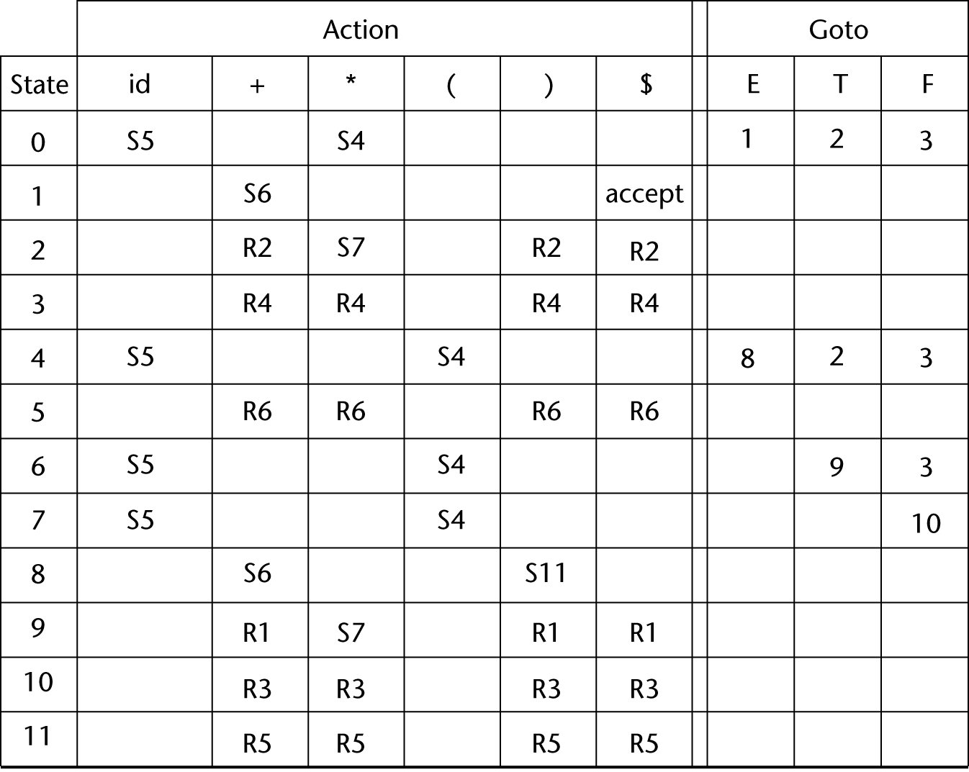
LR Parsing Table (reduce rules, next slide)
Copyright © 2015 Pearson. All rights reserved.
1-<number>

Slide 65
Bottom-up Parsing (continued)
Reduce rules:
1. E -> E + T
2. E -> T
3. T -> T * F
4. T -> F
5. F -> (E)
6. F -> id
Copyright © 2015 Pearson. All rights reserved.
1-<number>

Slide 66
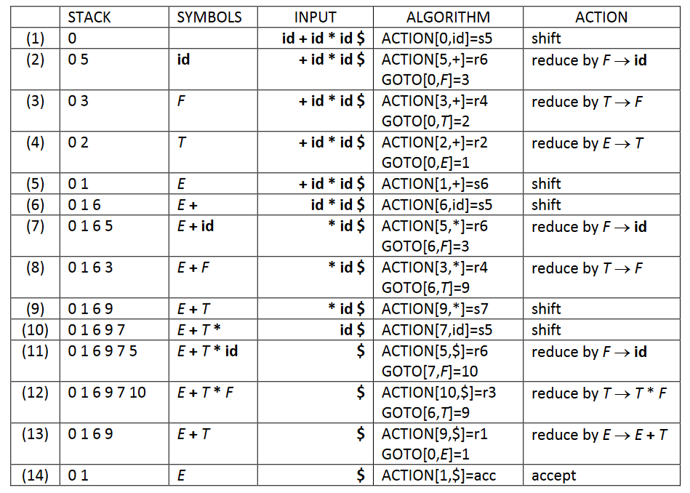
Copyright © 2015 Pearson. All rights reserved.
1-<number>

Slide 67
Bottom-up Parsing (continued)
A parser table can be generated from a given grammar with a tool, e.g., yacc or bison
Copyright © 2015 Pearson. All rights reserved.
1-<number>

Slide 68
Summary
Syntax analysis is a common part of language implementation
A lexical analyzer is a pattern matcher that isolates small-scale parts of a program
  Detects syntax errors
  Produces a parse tree
A recursive-descent parser is an LL parser
  EBNF
Parsing problem for bottom-up parsers: find the substring of current sentential form
The LR family of shift-reduce parsers is the most common bottom-up parsing approach
Copyright © 2015 Pearson. All rights reserved.
1-<number>

